Slide 1
Optimization and Applications
INDE 6620
Introduction to Operations Research
Dr. Marzieh Soltanolkottabi
Department of
Mechanical and Industrial Engineering

Slide 2
What is Operations Research?
Operations research (Management Science) is:
a scientiﬁc approach to decision making that seeks to best design and operate a system, usually under conditions requiring the allocation of scarce resources.
System is:
an organization of interdependent components that work together to accomplish the goal of the system.

Slide 3
What is Operations Research?
The scientific approach to decision making requires the use of one or more mathematical models.
A mathematical model is:
a mathematical representation of the actual situation that may be used to make better decisions or clarify the situation.

Slide 4
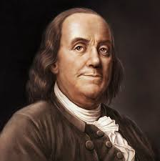
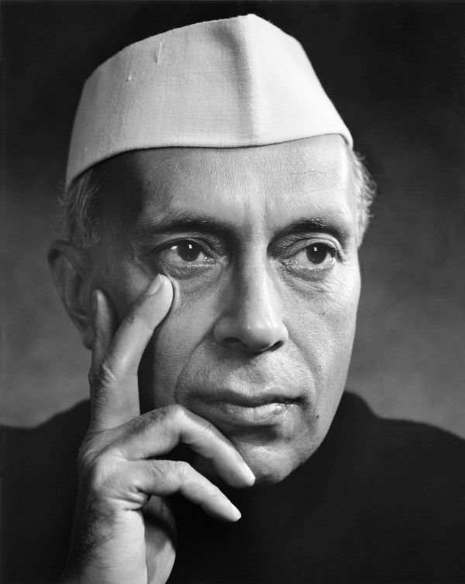
Voices from the past
Waste neither time nor money, but make the best use of both.
Benjamin Franklin
Obviously, the highest type of efficiency is that which can utilize existing material to the best advantage.
Jawaharlal Nehru

Slide 5
Operations Research Methods
Operations Research Methodologies:
Descriptive (D): describes the performance of a given system
Prescriptive (P): prescribe how a system should be designed or operated to perform the “best”
Some Branches of Operations Research Methodology:
Linear Programming (P), Network Programming (P), Decision Theory (P), Dynamic Programming (P), Markov Processes (D), Nonlinear Programming (P), Queuing Theory (D), Stochastic Optimization (P), Simulation (D)

Slide 6
Primary Objectives
Solve the model analytically
From any real world complex system, identify the appropriate methodology
Model the system accordingly
Solve the model computationally

Slide 7
Optimization is Everywhere
It is embedded in language, and part of the way we think.
Firms want to maximize value to shareholders
People want to make the best choices
We want the highest quality at the lowest price
When playing games, we want the best strategy
When we have too much to do, we want to optimize the use of our time
etc.
Look for it!
You will see opportunities for its use.
MIT and James Orlin ©2003
Notes:
American Airlines Optimal crew scheduling saves $20 million/year Optimal yield management contributes $500 million per year
Revenue management saves National Car rental $56 million in one year
Better truck dispatching at Reynolds Metals improves on-time delivery and reduces annual freight costs by $7 million
Improved shipment routing saves Yellow freight over $17.3 million/year
GTE local access capacity expansion saves $30 million per year
Optimizing its global supply chains saves Digital Equipment over $300 million
Restructuring North America operations, Proctor and Gamble reduces plants by 20%, saving $200 million/year
Taha Steel (India) maximizes production in response to power shortages contributing $73 million
Improved production planning at Sadia (Brazil) saves $50 million over three years
Production optimization at Harris Corporation improves on-time deliveries from 75% to 90%
Optimal traffic control of the Hanshin Expressway in Osaka saves 17 million driver hours with benefits of $320 million
Better scheduling of hydro and thermal generating units saves Southern Company $140 million

Slide 8
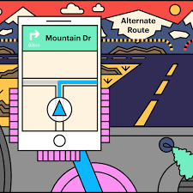
Operation Everything
Fastest route
Enough inventory with the minimum cost
Crews and aircrafts scheduling
Pricing the plane tickets and hotel rooms
which truck and which route
schedule team's games

Slide 9
Origins of Operations Research
World War II :
British and US military leaders asked scientists and engineers to analyze several military problems
E.g. Deployment of radar
Urgent need to allocate scare resources to military operations
The result was called Military Operations Research, later Operations Research
Origin Story: https://www.youtube.com/watch?v=ILWbaWrjgU4

Slide 10
Some Success Stories
Optimal crew scheduling saves American Airlines $20 million/yr.
Improved shipment routing saves Yellow Freight over $17.3 million/yr.
Production Optimization at Harris Corporation improves on-time deliveries from 75% to 90%.
Gasoline blending at Texaco results in saving of over $30 million/yr.
https://www.informs.org/Impact/O.R.-Analytics-Success-Stories
OR Impact: https://www.youtube.com/watch?v=sFWrmpXPVJw
Notes:
Mention Cindy Barnhart’s success at United Airlines: her fleet routing models are estimated to save United $100,000,000 per year.
Our solutions have an estimated savings of $25 million per year.
Mention our work with CSX.
Mention Interfaces.

Slide 11
Resources for Operations Research
INFORMS
(Institute for Operations Research and the Management Sciences)
https://www.informs.org/
The Operational Research Society
http://www.theorsociety.com/

Slide 12
What is Modeling?
Models are used to represent and analyze systems
It is really hard to represent real situations
Iconic
Schematic
Mathematical
“All models are wrong, but many are useful.”
George Box

Slide 13
What is Modeling?
Majority of operations research applications usually involve varying degrees of approximation.
We should abstract the assumed real world from the real situation by concentrating on the dominant variables that control the behavior of the real system.
A model should express in an amenable manner the mathematical functions that represent the behavior of the assumed real world.
Real World
Model
Assumed Real World

Slide 14
The Seven-Steps for Modeling
1.
Formulate the Problem
What is the problem?
What are the objectives?
2.
Observe the System
What parameters and data?
3.
Formulate a Mathematical Model of the Problem
Verify the Model and Use the Model for Prediction
Checking correctness and completeness.
4.
5.
Select a Suitable Alternative
6.
Present the Results and Conclusions
7.
Implement and Evaluate Recommendations

Slide 15
The Seven-Steps for Modeling
1. Formulate the Problem
Define the problem
Specify objectives
Determine parts of the organization to be studied
2. Observe the System
Determine parameters affecting the problem.
Collect data to estimate values of the parameters.
If you model the wrong problem, the results don’t matter!
Don’t find the right answer to the wrong problem.

Slide 16
The Seven-Steps for Modeling
3. Formulate a Mathematical Model of the Problem
4. Verify the Model and Use the Model for Prediction
Do the results make sense? Is this practical?
Did I forget any constraints or decision variable?
What eventualities might cause the model to become invalid?
5. Select a Suitable Alternative
Given a model and a set of alternative solutions, determine which solution best meets the organizations objectives.
Model formulation is more art than science; it takes practice, persistence, and patience.

Slide 17
The Seven-Steps for Modeling
6. Present the Results and Conclusion(s) of the Study to the Organization
Present the results to the decision maker(s)
If necessary, prepare several alternative solutions and permit the organization to chose the one that best meets their needs.
Any non-approval of the study’s recommendations may have stemmed from an incorrect problem definition or failure to involve the decision maker(s) from the start of the project.
In such a case, return to step 1, 2, or 3.
7. Implement and Evaluate Recommendations
Assist in implementing the recommendations.
Monitor and dynamically update the system as the environment and parameters change to ensure that recommendations enable the organization to meet its goals.

Slide 18
Basics of Mathematical Modeling
Ask 4 Questions:
What information is known/given?
What decisions must be made?
What is the goal of solving this problem?
What requirements must any acceptable solution satisfy?
4 Building Blocks:
Parameters
Decision Variables
Objective Function
Constraints
Choose values of decision variables to maximize (minimize) objective function subject to constraints
Notes:
Common mistake: mixing up decision variables with *given* information. Known constants are called parameters.

Slide 19
Basics of Mathematical Modeling
Mathematical Model
Uncontrollable Inputs
(Parameters)
Objective Function
Output (Projected Results)
Constraints
Controllable Inputs (Decision Variables)

Slide 20
Basics of Mathematical Modeling
Decision variables: e.g., x and y
In general, there are quantities you can control to improve your objective which should completely describe the set of decisions to be made.
Objective Function: e.g., z = 3x + 4y
Value measure used to rank alternatives
Seek to maximize or minimize this objective
examples: maximize NPV, minimize cost
Constraints: e.g., 5x + 8y ≤ 24
Limitations on the values of the decision variables.

Slide 21
Types of Prescriptive Models
Static or Dynamic:
A static model is one in which the decision variables do not involve sequences of decisions over multiple periods.
A dynamic model is a model in which the decision variables do involve sequences of decisions over multiple periods.
Linear or Nonlinear:
A linear model is one in which all constraints and objective functions can be deﬁned by a linear equation.
A nonlinear model has nonlinear constraints or objective function. In general, nonlinear models are much harder to solve.

Slide 22
Types of Prescriptive Models
Integer or Noninteger:
In an integer model one or more decision variables need to be integer.
In a noninteger model decision variables are free to assume fractional values.
Deterministic or Stochastic:
A deterministic model uses data that are assumed known with certainty.
A stochastic model used data that are random (capable of taking on any value from a range of values).
Deterministic models are common as they provide useful insight into decisions.

Slide 23
An OR Problem: OR-ange Company
OR-ange Co. runs a juice company and gets orange pulp from 2 sources: Georgia & Florida.
OR-ange Co. produces 3 grades of Orange Juice: A, B, and C.

Slide 24
OR-ange Co. Example
Florida oranges are superior to Georgia’s and each bushel of oranges produce the following:
The orange supply diﬀers in cost (based on transportation) and availability:
How can these Requirements be fulﬁlled most eﬃciently?
 | Grade A | Grade B | Grade C
Georgia (ounce/1 bushel) | 0.3 | 0.4 | 0.2
Florida (ounce/1 bushel) | 0.4 | 0.2 | 0.3
NEEDS (ounces/ day) | 2000 | 1500 | 500
 | Available (bushel) | Cost (per bushel)
Georgia | 9000 | $20
Florida | 6000 | $15

Slide 25
OR-ange Co. Example
1. Formulate the Problem
What is the problem?
We want to know how many bushel of oranges to buy from each source to fulfill the need for each grade of juice.
What are the objectives?
Fulfill our needs with the minimum cost
2. Observe the System
What are the parameters?
Cost of oranges, Capacities (each resource), Maximum requirements (needs), yields (Ounce/bushel)
What are the available data?

Slide 26
Optimization Model for OR-­ange
3. Formulate a Mathematical Model of the Problem
Decision Variables:
Variables whose values are under our control and inﬂuence system performance
X_{g} = the # of bushels of Georgia oranges processed per day (in thousands)
X_{f} = the # of bushels of Florida oranges processed per day (in thousands)
Parameters:
The uncontrollable inputs to the model.
Cost of oranges
Capacities
Maximum requirements
yields

Slide 27
Optimization Model for OR-­ange
Objective Function:
The scoring or ranking measure that is used to compare alternative solutions (usually a function we wish to maximize or minimize).
Minimize total cost to produce needed supply of OR-­ange Juice.
 | Available (bushel) | Cost (per bushel)
Georgia | 9000 | $20
Florida | 6000 | $15
Min 20 X_{g} + 15 X_{f}

Slide 28
Optimization Model for OR-­ange
Constraints:
Restrictions on the decision variable values.
Product Requirements:
Grade A: 0.3 x_{g} + 0.4 x_{f} >= 2.0
Grade B: 0.4 x_{g} + 0.2 x_{f} >= 1.5
Grade C: 0.2 x_{g} + 0.3 x_{f} >= 0.5
Capacity Requirements
Georgia Cap: x_{g} <= 9
Florida Cap: x_{f} <= 6
x_{g} >= 0, x_{f} >= 0
Don’t Forget These!

Slide 29
Complete Mathematical Model
X_{g} = the # of bushels of Georgia oranges processed per day (in thousands)
X_{f} = the # of bushels of Florida oranges processed per day (in thousands)
Min 20 x_{g} + 15 x_{f}
Subject to:
0.3 x_{g} + 0.4 x_{f} >= 2.0 (grade A)
0.4 x_{g} + 0.2 x_{f} >= 1.5 (grade B)
0.2 x_{g} + 0.3 x_{f} >= 0.5 (grade C)
x_{g} <= 9 (Georgia Cap)
x_{f} <= 6 (Florida Cap)
x_{g} >= 0, x_{f} >= 0

Slide 30
Optimal Solution to Our Model
4. Verify the Model and Use the Model for Prediction
Have we used all the decision variables?
Have we considered all the constraints?
Is the objective function correctly introduced?
Is our model complete?
Solution:
X_{g} = 2 thousand bushels of Georgia oranges per day
X_{f} = 3.5 thousand bushels of Florida oranges per day
Costs = 20(2) + 15(3.5) = 92.5 thousand dollars per day
Is this solution valid?

Slide 31
OR-ange Co. Example
5. Select a Suitable Alternative
The model has a minimum cost of 92.5 thousand dollars per day with X_{g} = 2 and X_{f} = 3.5
6. Present the Results and Conclusion(s) of the Study to the Organization
The OR-ange Company can minimize its cost while fulfilling all the demands by buying 2 thousand bushels of orange from Georgia and 3.5 thousand bushels of orange from Florida per day. The cost of such order is 92.5 thousand dollars per day for the company
7. Implement and Evaluate Recommendations

