Slide 1
Decision Making Under Uncertainty
EGRM 6611
Probability Distributions and Applications
Dr. Marzieh Soltanolkottabi
Department of
Mechanical and Industrial Engineering

Slide 2
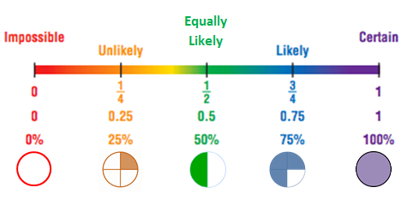
Probability
Probability is the likelihood that the event will occur.
Two Conditions:
  Value is between 0 and 1.
  Sum of the probabilities of all events must be 1.

Slide 3
Random Variable
A numerical description of the outcome of an experiment (x)
Discrete Random Variable:
Random variables have a countable number of outcomes.
  Throw a dice twice: Count the number of times 4 comes up (0, 1, or 2 times)
Continues Random Variable:
Random variables have an infinite continuum of possible values.
  The Value of a stock
  Time to repair a failed machine

Slide 4
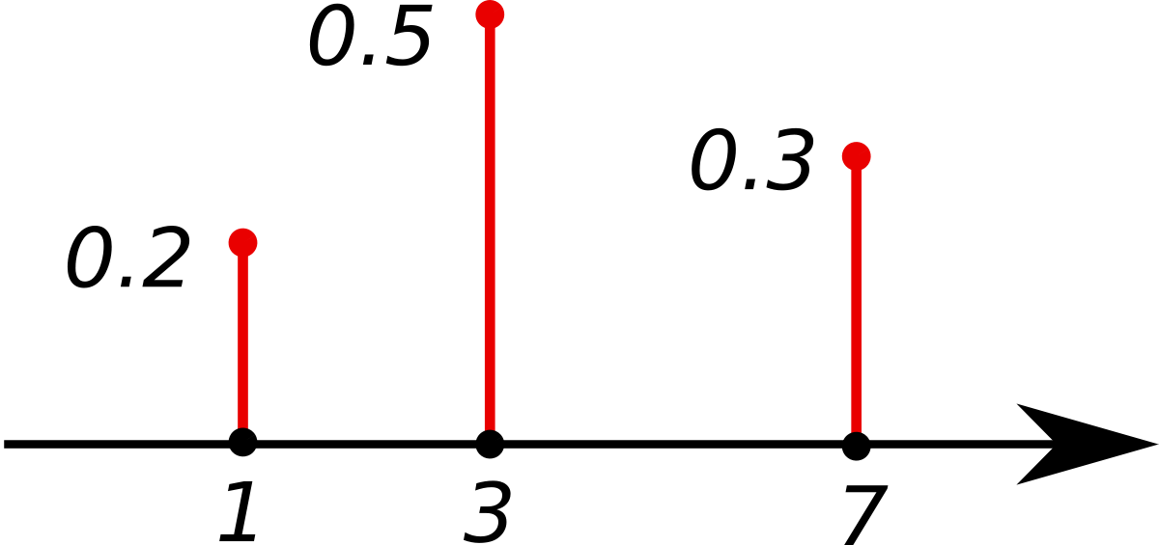
Probability functions
A probability function maps the possible values of RV (x) against their respective probabilities of occurrence, p(x)
  Value is between 0 and 1.
  Sum of the probabilities must be 1.
Notes:
It turns out that if you were to go out and sample many, many times, most sample statistics that you could calculate would follow a normal distribution.
What are the 2 parameters (from last time) that define any normal distribution?
Remember that a normal curve is characterized by two parameters, a mean and a variability (SD)
What do you think the mean value of a sample statistic would be? The standard deviation?
Remember standard deviation is natural variability of the population
Standard error can be standard error of the mean or standard error of the odds ratio or standard error of the difference of 2 means, etc. The standard error of any sample statistic.

Slide 5
Weekly Demand of a Product
Probability Mass Function (PMF)
Cumulative Distribution Function (CDF)
Demand, x | Probability, p(x)
0 | 0.1
1 | 0.2
2 | 0.4
3 | 0.3
4 or more | 0
Demand, x | Cumulative Probability, P(x)
0 | 0.1
1 | 0.3
2 | 0.7
3 | 1
4 or more | 1
Probability that RV has a value <= a given value, x

Slide 6
Practice Problem
The number of ships to arrive at a harbor on any given day is a random variable represented by x. The probability distribution for x is:
x
10
11
12
13
14
P(x)
.4
.2
.2
.1
.1
Find the probability that on a given day:
a. Exactly 14 ships arrive
b. At least 12 ships arrive
c. At most 11 ships arrive
p(x=14) = .1
p(x≥12) = (.2 + .1 +.1) = .4
p(x≤11) = (.4 +.2) = .6

Slide 7
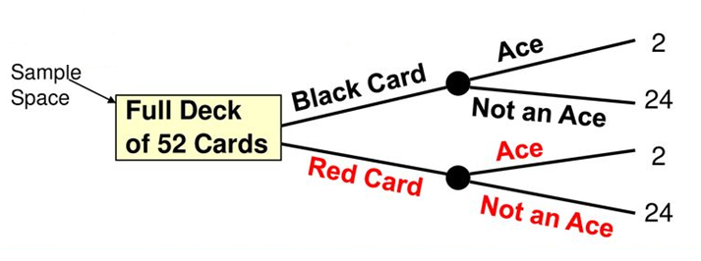
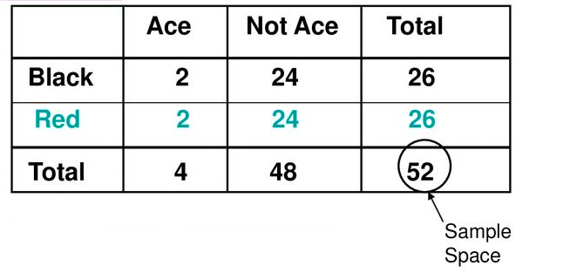
Sample space and Events
Simple Event: Outcome from a Sample Space with 1 Characteristic
A Red Card from a deck of cards.
Joint Event: Involves 2 Outcomes Simultaneously
An Ace which is also a Red Card from a deck of cards.

Slide 8
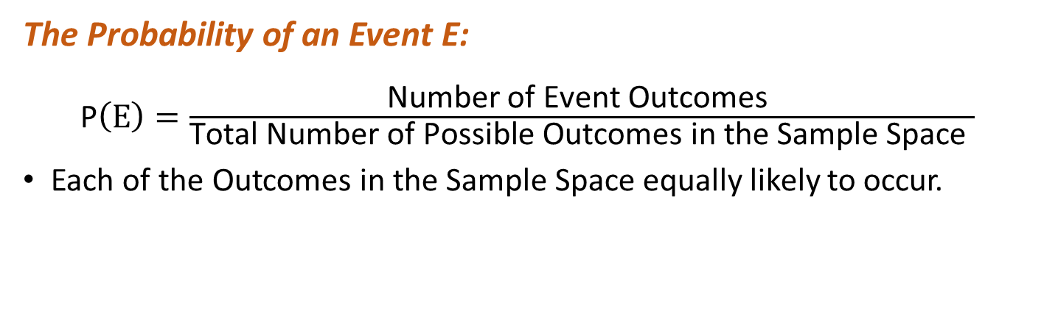

Computing Probability
The Probability of an Event E:
P$\left(E\right)=\frac{\text{Number} \text{of} \text{Event} \text{Outcomes} }{\text{Total} \text{Number} \text{of} \text{Possible} \text{Outcomes} \text{in} \text{the} \text{Sample} \text{Space} }$
Each of the Outcomes in the Sample Space equally likely to occur.
$$P\left(Red Card\right)=$$
$\frac{26 Red Aces}{52 total number of cards}$= $\frac{26}{52}$

Slide 9
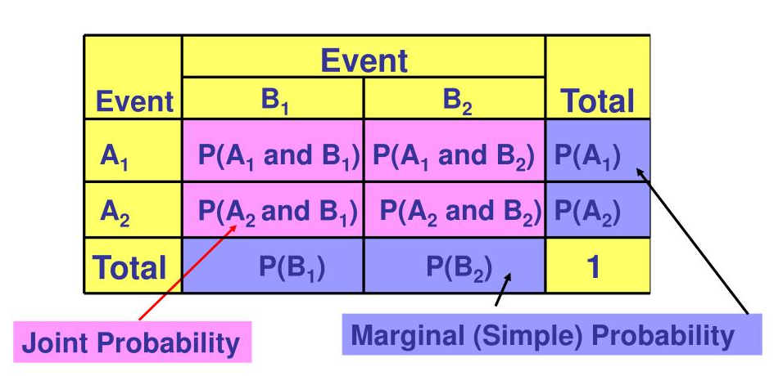


Computing Joint Probability
The Probability of a Joint Event, A and B:
P$\left(A and B\right)=\frac{\text{Number} \text{of} \text{Event} \text{Outcomes} \text{from} \text{both} \text{A} \text{and} \text{B} }{\text{Total} \text{Number} \text{of} \text{Possible} \text{Outcomes} \text{in} \text{Sample} \text{Space} }$
$$P\left(Red Card and Ace\right)=$$
$\frac{2 Red Aces}{52 total number of cards}$= $\frac{1}{26}$

Slide 10
Computing Marginal Probability
Marginal probability:
Where B₁, B₂, …, B_{k} are k mutually exclusive and collectively exhaustive events.
$$P(A)=P(A \text{and} B_{1})+P(A \text{and} B_{2})+⋯+P(A \text{an}d B_{k})$$
$$P\left(Red Card\right)=$$
$P\left(Red and Ace\right)+P(Red and Not Ace)$= $\frac{2}{52}$ + $\frac{24}{52}$=$\frac{26}{52}$

Slide 11
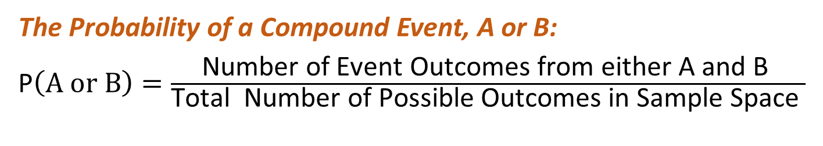
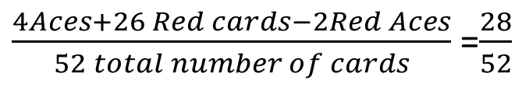

Computing Compound Probability
The Probability of a Compound Event, A or B:
P$\left(A or B\right)=\frac{\text{Number} \text{of} \text{Event} \text{Outcomes} \text{from} \text{either} \text{A} \text{and} \text{B} }{\text{Total} \text{Number} \text{of} \text{Possible} \text{Outcomes} \text{in} \text{Sample} \text{Space} }$
P(A or B ) = P(A) +P(B) - P(A and B)
$$P\left(Red Card or Ace\right)=$$
$\frac{4Aces+26 Red cards−2Red Aces}{52 total number of cards}$=$\frac{28}{52}$

Slide 12

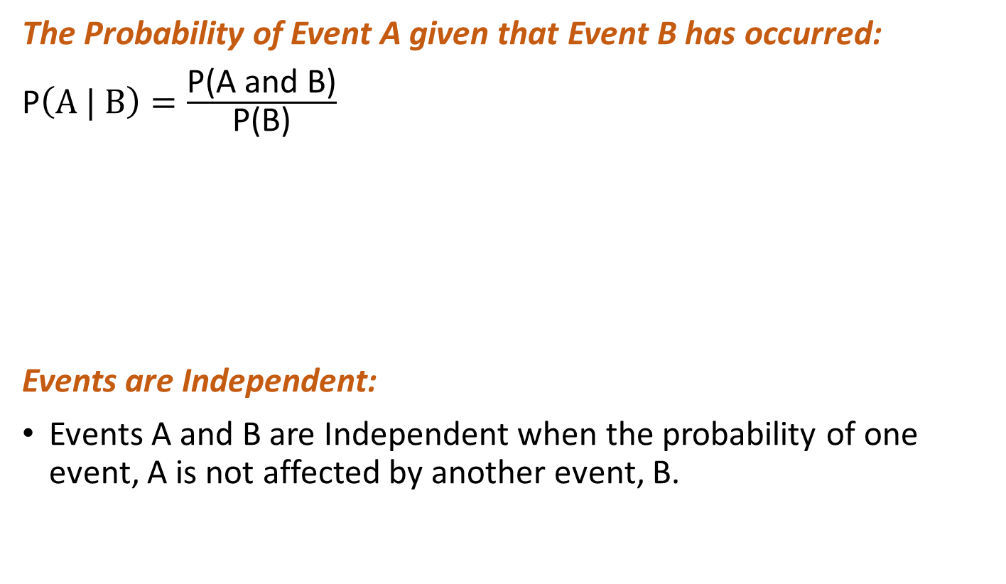
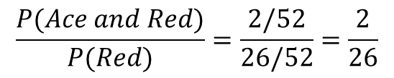
Computing Conditional Probability
The Probability of Event A given that Event B has occurred:
P$\left(A | B\right)=\frac{\text{P}\text{(}\text{A} \text{and} \text{B}\text{)}}{\text{P}\text{(}\text{B}\text{)}}$
Events are Independent:
Events A and B are Independent when the probability of one event, A is not affected by another event, B.
$$P\left(Ace | Red\right)=$$
$$\frac{P(Ace and Red)}{P(Red)}=\frac{2/52}{26/52}=\frac{2}{26}$$
P(A|B) = P(A)
Or, P(B|A) = P(B)
Or, P(A and B) = P(A)P(B)

Slide 13
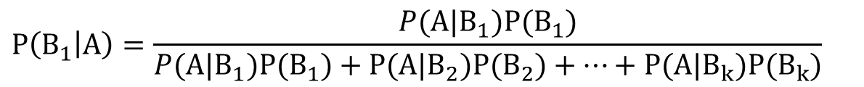
Bayes’ Theorim
$$P\left(B_{1} | A\right)=\frac{P(A|B_{1})P(B_{1})}{P(A|B_{1})P(B_{1})+P(A|B_{2})P(B_{2})+⋯+P(A|B_{k})P(B_{k})}$$
B₁, B₂, …, B_{k} are k mutually exclusive and collectively exhaustive events

Slide 14
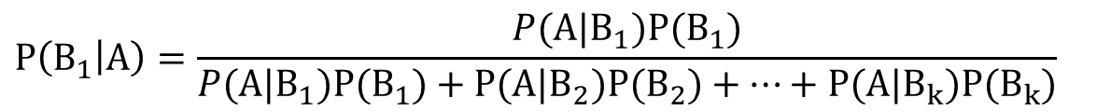
Bayes’ Theorem Example
$$P\left(B_{1} | A\right)=\frac{P(A|B_{1})P(B_{1})}{P(A|B_{1})P(B_{1})+P(A|B_{2})P(B_{2})+⋯+P(A|B_{k})P(B_{k})}$$
Given the following statistics, what is the probability that a woman has cancer if she has a positive mammogram result?
  One percent of women have breast cancer.
  Ninety percent of women who have breast cancer test positive on mammograms.
  Eight percent of women will have false positives.
You want to know what a woman’s probability of having cancer is, given a positive mammogram.
  P(C)=0.01 P(C’)=0.99
  P(X|C)=0.9 P(X|C’)=0.08
C = having cancer
X = a positive test result
  P(C|X)=P(X|C)P(C)/P(X)= (P(X|C)P(C))/(P(X|C)P(C)+P(X|C’)P(C’))=
(0.9 * 0.01) / ((0.9 * 0.01) + (0.08 * 0.99)) = 0.10

Slide 15
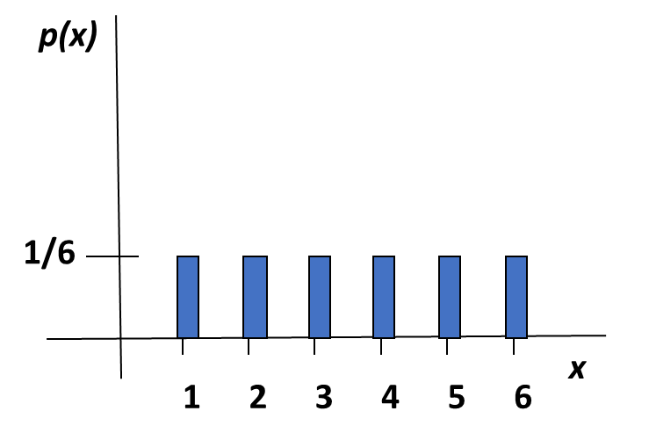
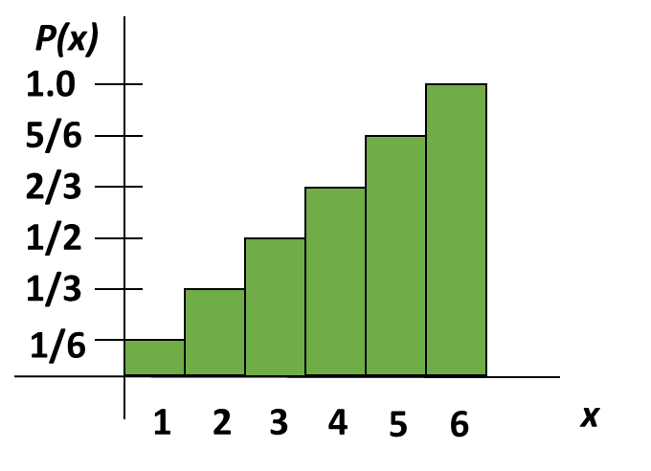
Discrete Probability Distribution
List of all possible [ x_{i}, p(x_{i}) ] pairs
X_{i} = value of random variable
P(x_{i}) = probability associated with value
Mutually exclusive (nothing in common)
Collectively exhaustive (nothing left out)
Example: Roll of a dice
0 ≤ p(x_{i}) ≤ 1
Σ P(x_{i}) = 1

Slide 16
Summary Measures
Expected value (The mean):
Weighted average of the probability distribution
μ = E(X) = ∑x_{i} p(x_{i})
Variance:
Expectation of the squared deviation of a random variable from its mean
Var[X] = σ² = Σ (x_{i} - E(X) )²p(x_{i})
  Standard deviation[X] = σ

Slide 17
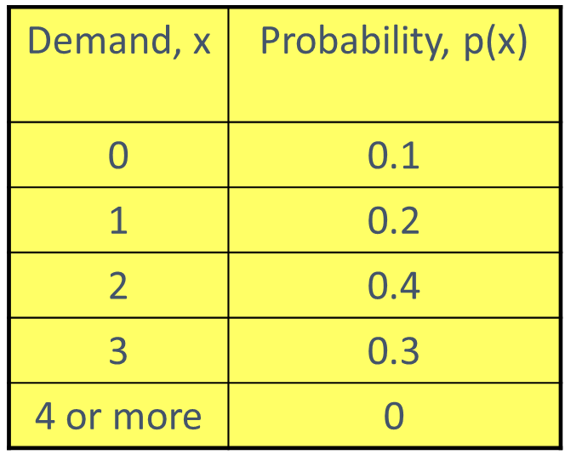
Summary Measures
In product demand example:
E(X) = 0 × 0.1 + 1 ×.2 + 2 × .4 + 3 × .3 = 1.9
Var[X] = σ² = (0 – 1.9)²(.1) + (1 – 1.9)²(.2) + (2 – 1.9)²(.4) + (3 – 1.9)²(.3) = .89

Slide 18
Survey question 1
Which alternative would you prefer:
A sure gain of $240
A 25% chance of winning $1000 and a 75% chance of winning nothing.
E(B) = .25 *$1000 + .75 *$0 = $250
E(A) = $240
E(A) < E(B)
85% prefer option A to option B

Slide 19
Survey question 2
Which alternative would you prefer:
A sure loss of $750
A 75% chance of losing $1000 and a 25% chance of losing nothing
E(B) = .75 *-1000 + .25 *$0 = -750
E(A) = -750
E(A) = E(B)
91% prefer option B to option A

Slide 20
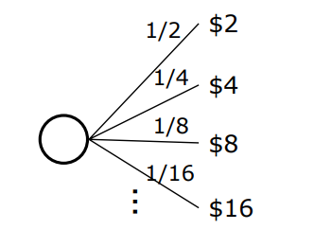
St. Petersburg Paradox
We flip a coin. If it comes up heads, I’ll pay you $2. If it comes up tails, we’ll flip again, and if it comes up heads, I’ll pay you $4. If it comes up tails, we’ll flip again, and if it comes up heads, I’ll pay you $8. And so on, out to infinity.
Most people don’t want to pay more than about $4 to play it.

Slide 21
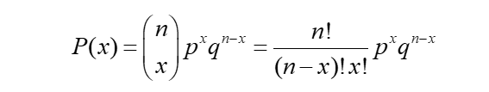


Binomial Distribution
The probability of obtaining x successes in n trials when the probability of success is p (probability of failure is q = 1-p) assuming p remains constant from trial to trial and that the trials are statistically independent of each other.
Mean:
Variance:
Example:
What is the probability of two success in five observations if the probability of an event of interest is 0.1?
BINOM.DIST(number of success, trials, probability of success, cumulative)
$$E\left(x\right)=np$$
$$σ^{2}=np(1−p)$$
BINOM.DIST(2, 5, 0.1, False)

Slide 22


Poisson Distribution
  The probability of a given number of events occurring in a fixed interval assuming the probability of success is Independent from interval to Interval
Mean:
Variance:
Example:
Find the probability of 4 customers arriving in a minute when the mean arrival time is 3.6 per minute.
e ^{-µ}µ^{x}
P(x) =
x!
µ = expected (mean) number of successes
POISSON.DIST(x, mean, cumulative)
$$E\left(x\right)=μ$$
$$σ^{2}=μ$$
POISSON.DIST(4, 3.6, False)

Slide 23
Continuous Probability Distributions
Probability density function f(x) describes the probability of outcomes for a continuous random variable X.
  f(x) ≥ 0 for all x
  Total area under f(x) = 1
  P(X = x) = 0
  Define probabilities over intervals: P(a ≤ X ≤ b), P(X < c), P(X > d)
f(x)
Area under curve
sums to one.
Random variable range

Slide 24
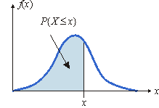
Cumulative Distribution Function
F(x) specifies the probability that the random variable X will be less than or equal to x; that is, P(X ≤ x).
F(x) is equal to the area under f(x) to the left of x

Slide 25
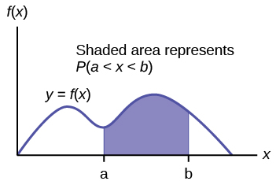
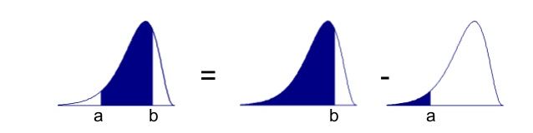
P(a ≤ X ≤ b)
The probability that X is between a and b is the area under f(x) from a to b:
P(a ≤ X ≤ b) = P(X ≤b) - P(X ≤ a) = F(b) – F(a)

Slide 26
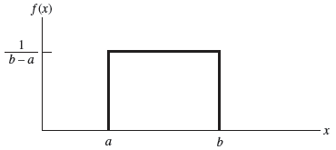

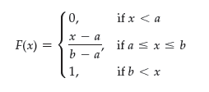
Uniform Distribution
Mean:
Variance:
Example:
If x has a uniform distribution between 3 and 6, what is the probability of 3<x<5?
E[X] = (a + b)/2
V[X] = (b – a)²/12
2/3-0=2/3

Slide 27
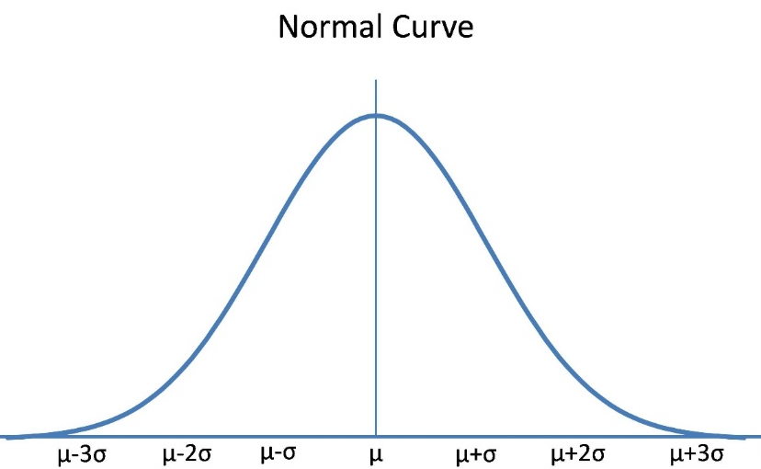
Normal Distribution
Symmetric, median = mean = mode
Range is unbounded: the curve never touches the x-axis
Mean:
Variance:
μ
σ²
NORM.DIST(x, mean, standard_deviation, cumulative )
  calculates the cumulative probability F(x) = P(X ≤ x) for a specified mean and standard deviation.

Slide 28
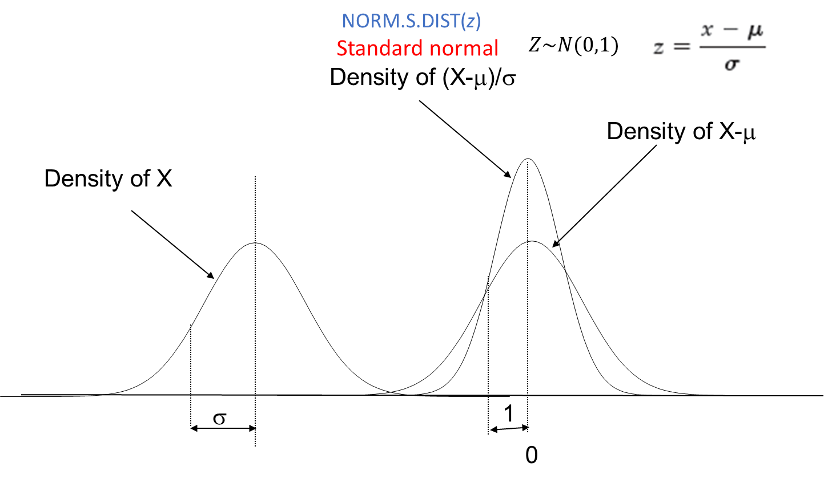
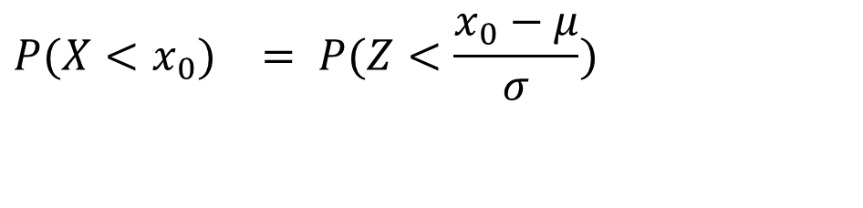
Standard Normal Distribution
$$\begin{matrix}P(X<x_{0}) & = P(Z<\frac{x_{0}−μ}{σ}) & \\ & & \\ & & \end{matrix}$$

Slide 29
Example
Customer demand (X) is normal with a mean of 750 units/month and a standard deviation of 100 units/month.
What is the probability that demand will be at most 900 units?
What is the probability that demand will exceed 700 units?
What is the probability that demand will be between 700 and 900 units?
What level of demand would be exceeded at 10% of the time?

Slide 30
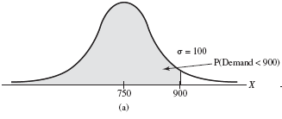
P(X<900)
What is the probability that demand will be at most 900 units?
NORM.DIST(900,750,100,TRUE) = 0.9332

Slide 31
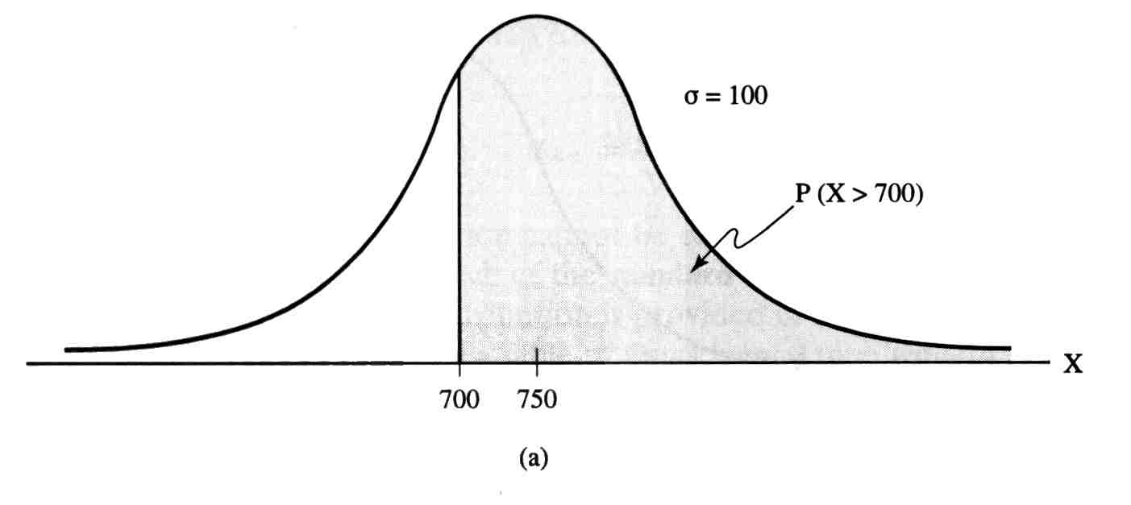
P(X>700)
What is the probability that demand will exceed 700 units?
P(X >700) = 1 - P(X < 700)
= 1 – F (700)
= 1 - 0.3085
= 0.6915
= 1 - NORM.DIST(700,750,100,TRUE)

Slide 32
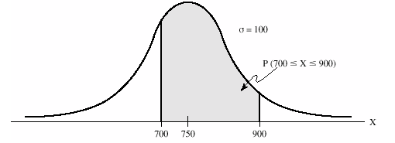
P(700<X<900)
What is the probability that demand will be between 700 and 900 units?
P(700 < X < 900)
= F(900) – F(700)
= 0.9332 - 0.3085
= 0.6247
= NORM.DIST(900,750,100,TRUE) – NORM.DIST(700,750,100,TRUE)

Slide 33
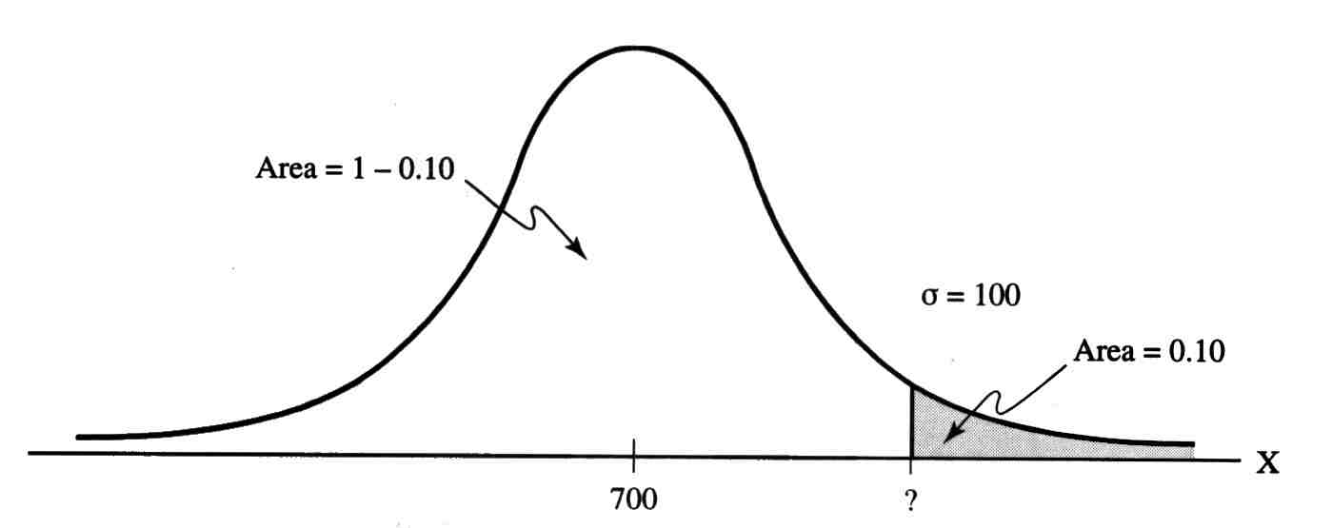
P(X>x) = 0.10
What level of demand would be exceeded at 10% of the time?
NORM.INV(Probability, mean, standard_deviation)
NORM.INV(0.90,750,100) = 878.155
x = 878

Slide 34
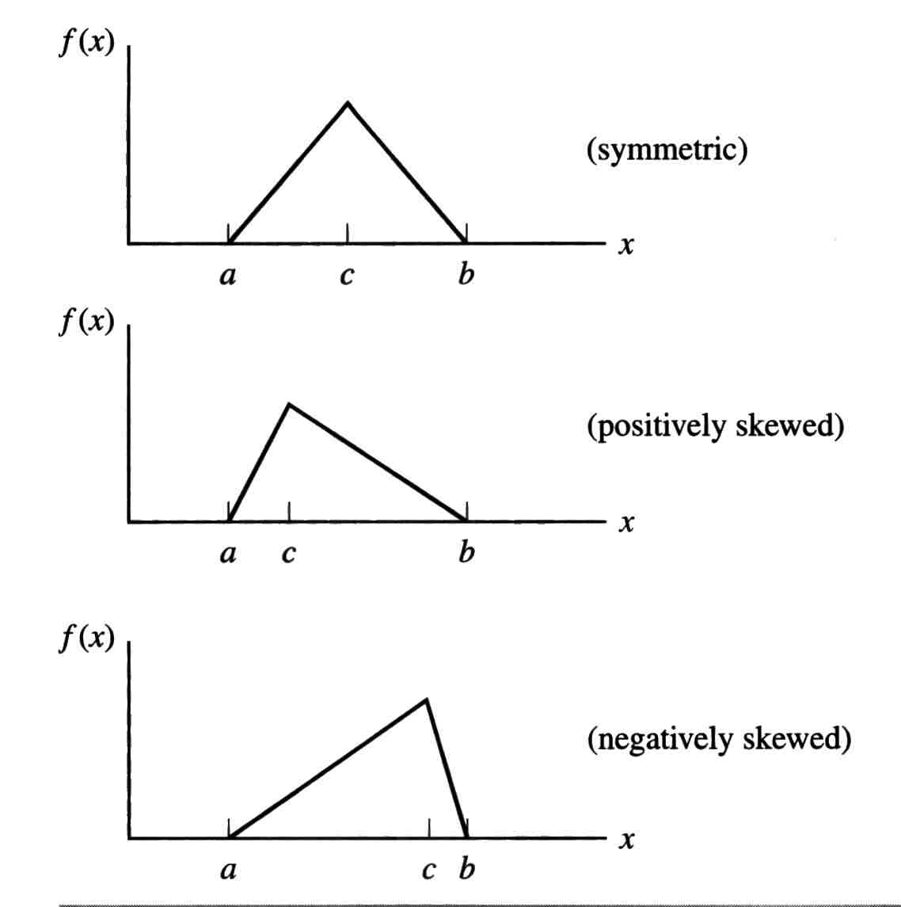
Triangular Distribution
Three parameters:
  Minimum, a
  Maximum, b
  Most likely, c
Mean:
Variance:
E[X] = (a + b + c)/3
V[X] = (a² + b² + c² – ab – ac – bc)/18

Slide 35
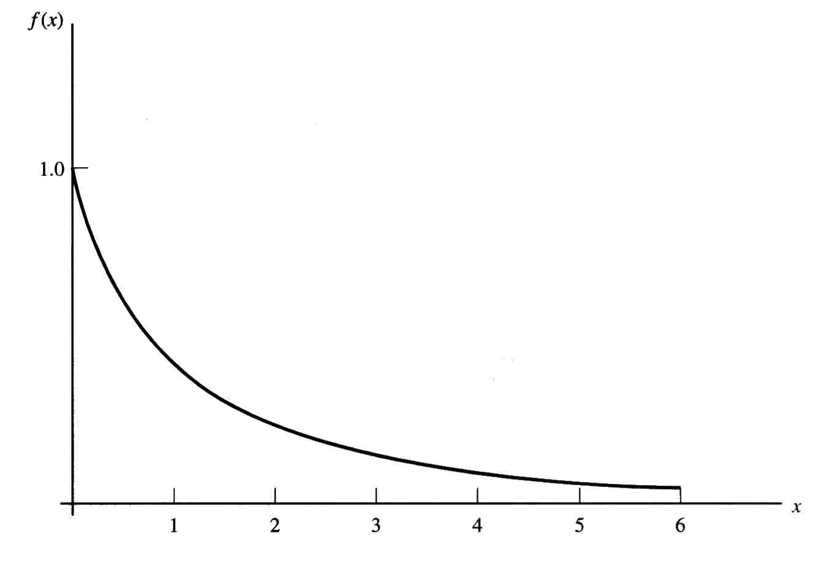


Exponential Distribution
It is the probability distribution of the time between events in a Poisson point process
λ= rate of occurrence
EXPON.DIST(x, lambda, cumulative)
Mean:
Variance:
E[X] = 1/λ
V[X] = 1/λ²

Slide 36
Continuous Distributions
Foundations for much of statistical inference
  Normal Distribution
  Log Normal Distribution
  Gamma Distribution
  Chi Square Distribution
  F Distribution
  t Distribution
  Weibull Distribution
  Extreme Value Distribution (Type I and II)
Environmental variables
Time to failure, radioactivity
Basis for statistical tests.
Lifetime distributions

